Slide 1
Graphs (cont.)

Slide 2
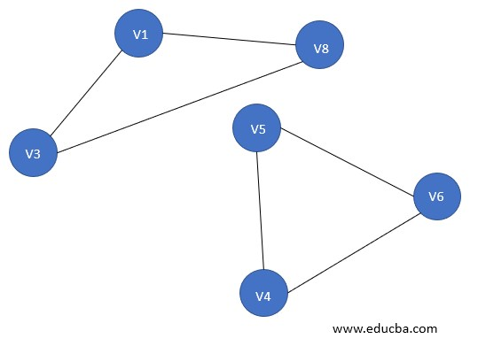
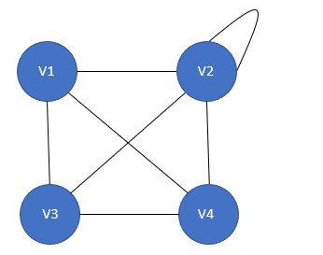
Connected and Disconnected Graphs
Connected Graph Disconnected Graph

Slide 3
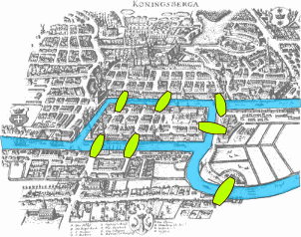
Königsberg problem
The town of Königsberg consists of two islands and seven bridges. Is it possible, by beginning anywhere and ending anywhere, to walk through the town by crossing all seven bridges but not crossing any bridge twice?
Notes:
There is a theorem that Euler used to show that it is in fact impossible to walk through the town and traverse all the bridges only once.

Slide 4
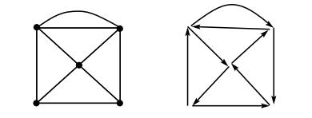
Terminology
Eulerian trail: An Eulerian trail is a trail that visits every edge of the graph once and only once. It can end on a vertex different from the one on which it began. A graph of this kind is said to be traversable.
Eulerian Circuit: An Eulerian circuit is an Eulerian trail that is a circuit. That is, it begins and ends on the same vertex.
Eulerian Graph: A graph is called Eulerian when it contains an Eulerian circuit.
The actual graph is on the left with a possible
solution trail on the right - starting bottom
left corner.

Slide 5
Theorem
An Eulerian trail exists in a connected graph if and only if there are either no odd vertices or two odd vertices.
NOTE: A vertex is odd if its degree is odd and even if its degree is even.
For the case of no odd vertices, the path can begin at any vertex and will end there; for the case of two odd vertices, the path must begin at one odd vertex and end at the other. Any finite connected graph with two odd vertices is traversable. A traversable trail may begin at either odd vertex and will end at the other odd vertex.
From this we can see that it is not possible to solve the bridges of Königsberg problem because there exists within the graph more than 2 vertices of odd degree.

Slide 6
Terminology
Hamiltonian Circuit: A Hamiltonian circuit in a graph is a closed path that visits every vertex in the graph exactly once. (Such a closed loop must be a cycle.)
A Hamiltonian circuit ends up at the vertex from where it started.
This type of problem is often referred to as the traveling salesman or postman problem.
Hamiltonian Graph: If a graph has a Hamiltonian circuit, then the graph is called a Hamiltonian graph.

Slide 7
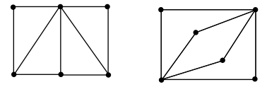
Eulerian & Hamiltonian Circuits
An Eulerian circuit traverses every edge in a graph exactly once, but may repeat vertices, while a Hamiltonian circuit visits each vertex in a graph exactly once but may repeat edges.
On the left, the graph is Hamiltonian and non-Eulerian, and
on the right, the graph is Eulerian and non-Hamiltonian.

Slide 8
Spanning Trees
A spanning tree is a subset of Graph G, which has all the vertices covered with minimum possible number of edges. Hence, a spanning tree does not have cycles and it cannot be disconnected..
By this definition, we can draw a conclusion that every connected and undirected Graph G has at least one spanning tree. A disconnected graph does not have any spanning tree, as it cannot be spanned to all its vertices.

Slide 9
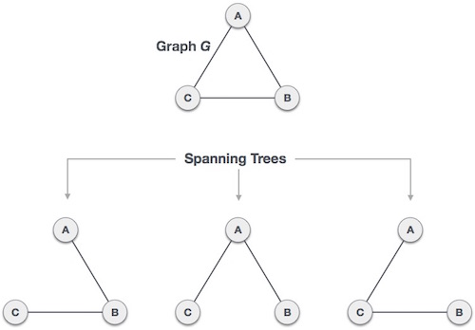
Spanning Trees
A complete undirected graph can have maximum n^{n-2} number of spanning trees, where n is the number of nodes.
In the above addressed example, n is 3, hence 3³⁻² = 3 spanning trees are possible.

Slide 10
General Properties of Spanning Trees
A connected graph G can have more than one spanning tree.
All possible spanning trees of graph G, have the same number of edges and vertices.
The spanning tree does not have any cycle (loops).
Removing one edge from the spanning tree will make the graph disconnected, i.e. the spanning tree is minimally connected.
Adding one edge to the spanning tree will create a circuit or loop, i.e. the spanning tree is maximally acyclic.

Slide 11
Mathematical Properties of Spanning Trees
Spanning tree has n-1 edges, where n is the number of nodes (vertices).
From a complete graph, by removing maximum e - n + 1 edges, we can construct a spanning tree.
A complete graph can have maximum nn-2 number of spanning trees.
Thus, we can conclude that spanning trees are a subset of connected Graph G and disconnected graphs do not have spanning tree.

Slide 12
Applications of Spanning Trees
Spanning tree is basically used to find a minimum path to connect all nodes in a graph. Common application of spanning trees are −
Civil Network Planning
Computer Network Routing Protocol
Cluster Analysis
Consider, city network as a huge graph and now plans to deploy telephone lines in such a way that in minimum lines we can connect to all city nodes. This is where the spanning tree comes into picture.

Slide 13
Minimum Spanning Tree (MST)
In a weighted graph, a minimum spanning tree is a spanning tree that has minimum weight than all other spanning trees of the same graph. In real-world situations, this weight can be measured as distance, congestion, traffic load or any arbitrary value denoted to the edges.

Slide 14

Problem : Number of connected components in undirected graph
Given n nodes labeled from 0 to n - 1 and a list of undirected edges (each edge is a pair of nodes), write a function to find the number of connected components in an undirected graph.
Example : Given n = 5 and edges = [[0, 1], [1, 2], [3, 4]]
Ans : 2

Slide 15
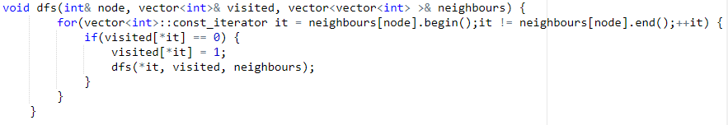
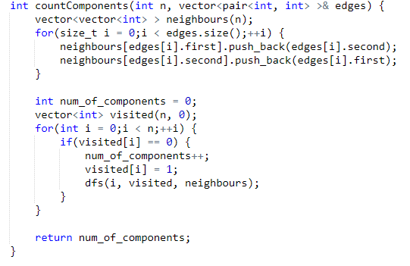
Implementation
Example : Given n = 5 and
edges = [[0, 1], [1, 2], [3, 4]]

Slide 16
Dijkstra’s Algorithm
Given a graph and a source vertex in the graph, find shortest paths from source to all vertices in the given graph.

